Slide 1

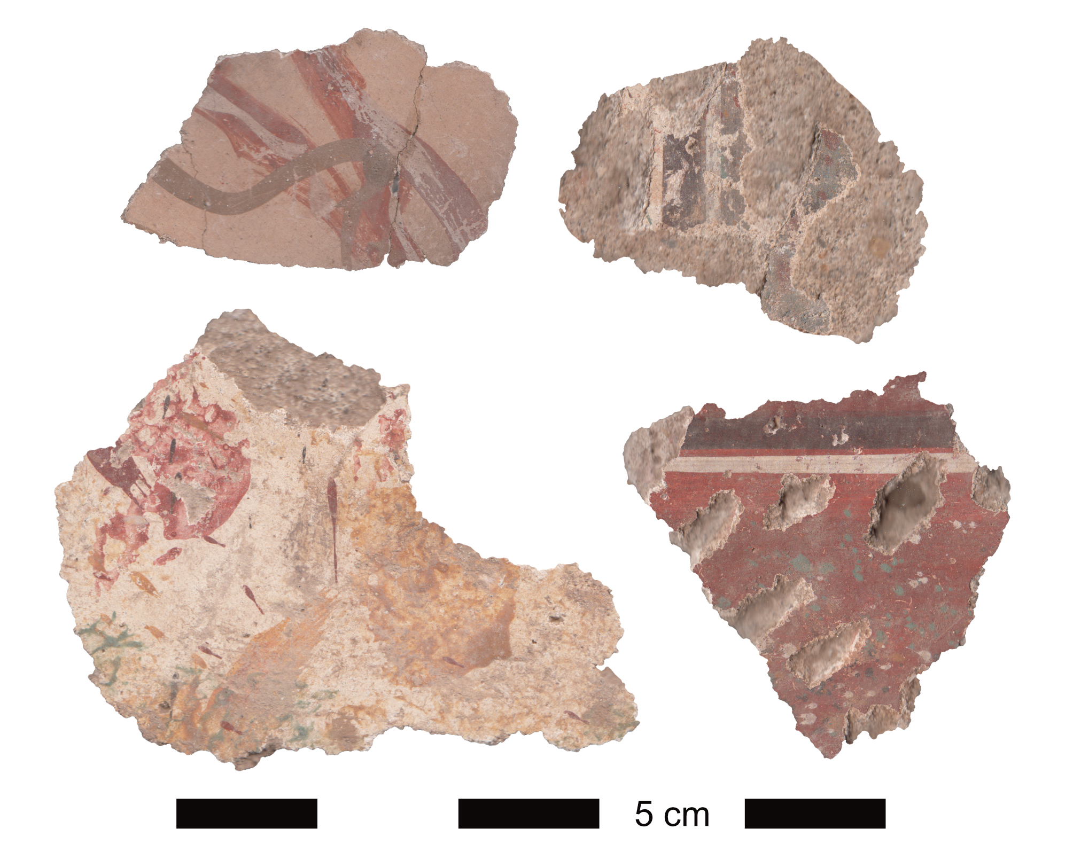
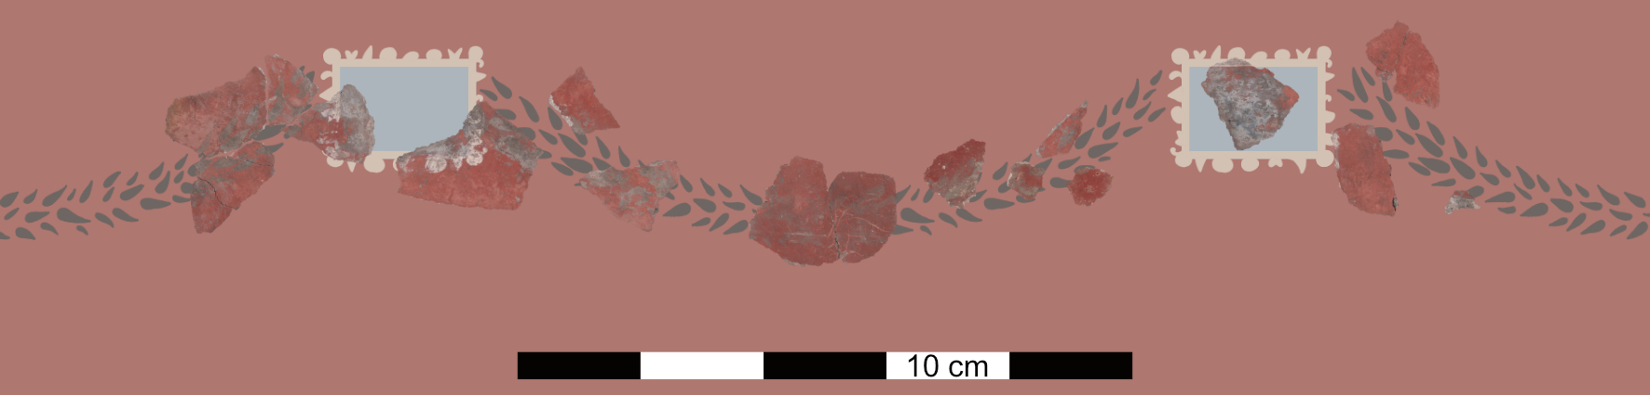
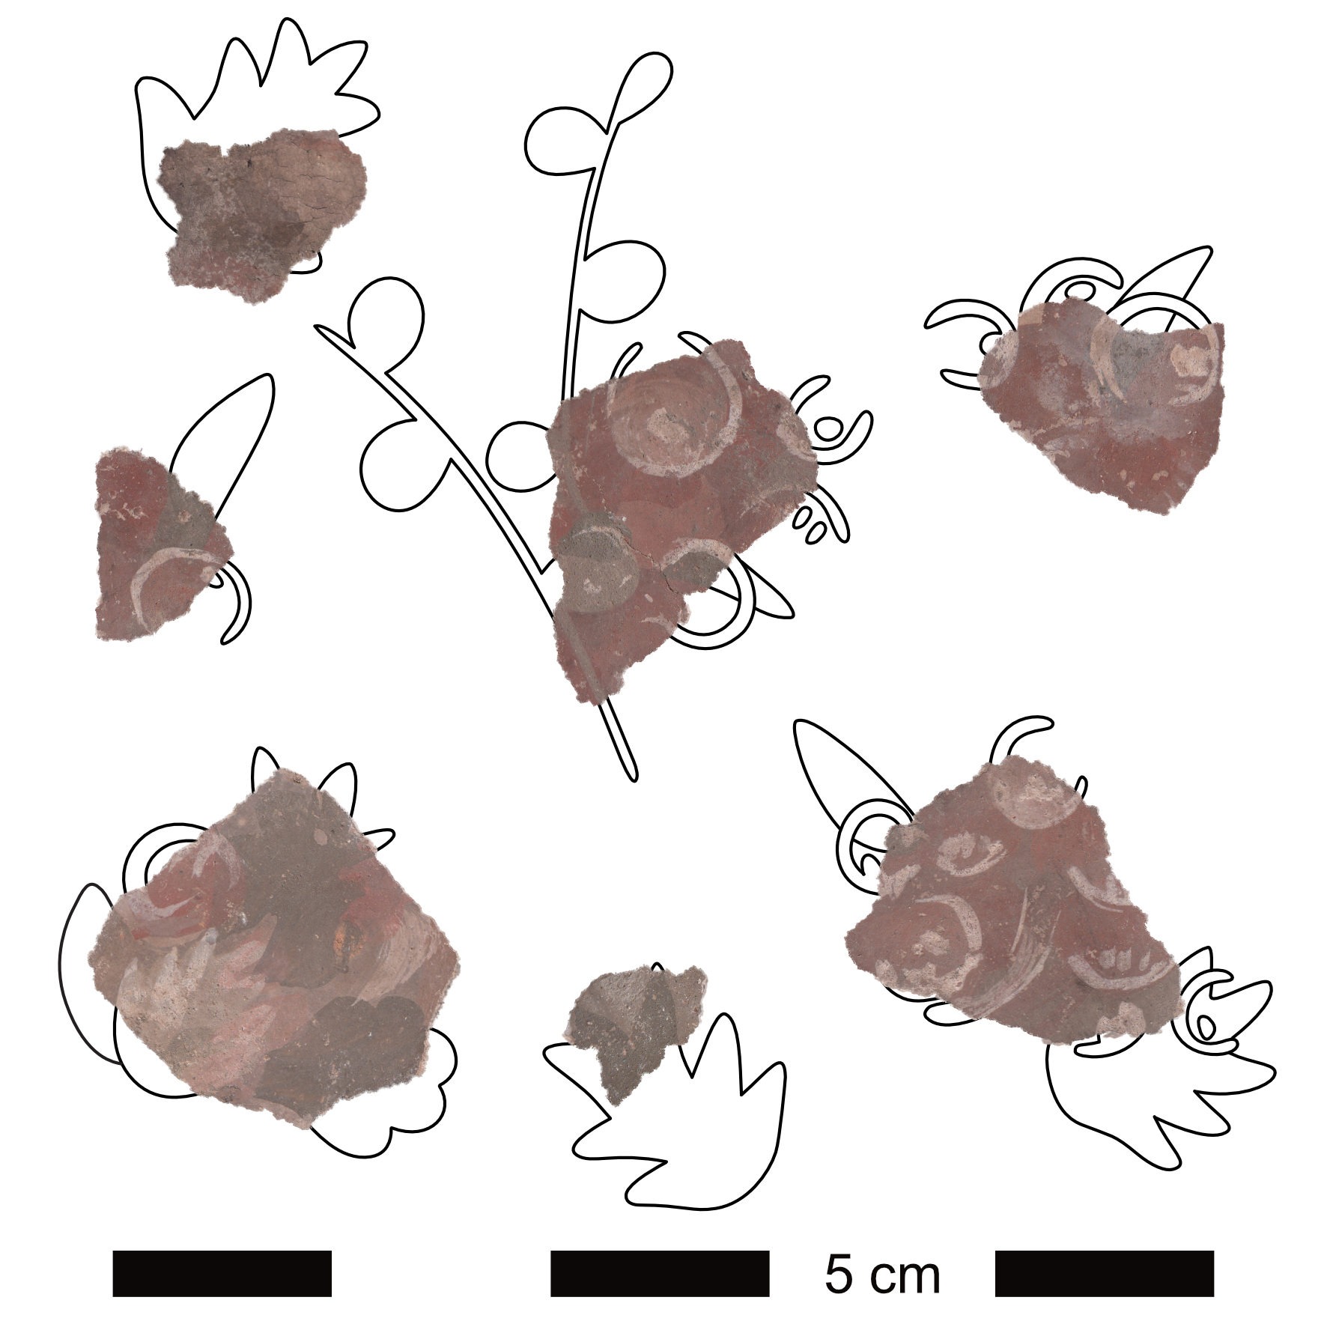
New wall paintings from Iuvavum/Salzburg
Partial reconstructions of wall paintings excavated at the „Neue Residenz”
Authors: Oskar Gufler (University of Salzburg), Barbara Tober (Salzburg)
The building remains
During rescue excavations at the “Neue Residenz” in 2001 a Roman residential building, dating from the 2nd to 4th centuries AD, was discovered beneath the former post office hall. It was a large complex, but due to the modern buildings present in the area, only the western part could be excavated. The examined remains consisted of a corridor and four rooms, including a hypocaust heating system in one of them. Several phases of alteration and traces of destruction by fire were noticed by the excavators. Numerous fragments of wall paintings and stucco were found, some of which showed distinct traces of fire damage.
The Salzburg Museum provided a selection of four crates for a course for students at the University of Salzburg. The task was to document the fragments in order to gain a better understanding for the find category of wall painting fragments. A number of partial reconstructions now enrich our understanding of Roman wall paintings in Salzburg.
Garlands hanging from white rectangles (Fig. 1)
A partial reconstruction depicts white rectangles with thin garlands of green leaves on a red background. The rectangular shapes are filled with light blue and are ornamented with rounded and triangular shapes on the outer edges. A similar example of these rectangles was found at La Roquebrussanne, where they were additionally placed on white vertical lines and belonged to a ceiling, dating to the 1st or 2nd century AC. Curving garlands of green pointed leaves hang from both sides of these decorated rectangles. This combination of ornaments is new to Noricum.
Marble imitations (Fig. 3)
There were multiple fragments found which depict the remains of marble imitations in various designs. Small splashes can be seen on red background with white and black horizontal lines separating it from the middle zone above. Similar splashes are found on green or turquoise ground, which show black and white dividing lines as well. This time, the lines seem to be running vertically, possibly with multiple panels of the green-ground marble imitation next to each other. There was also one fragment found with large colourful speckles on white, and multiple fragments of green and red curved lines on yellow with white highlights. Nevertheless, these loops could have possibly been meant to resemble vines, rather than marble.
Fig. 3. A selection of fragments depicting varying marble imitations
Summary
In addition to the here discussed partial reconstructions, red and green frames on yellow ground add to the diversity of Roman decorative painting systems known from Iuvavum/Salzburg. As very few painting schemes from Salzburg have been published to date, every partial reconstruction contributes to a better understanding of Roman interior decoration in Noricum. In recent years, a further area has been excavated, yielding numerous paintings, both intact and in fragments.
Bibliography
I. Dörfler, Die römische Wandmalerei aus dem südlichen Noricum: Magdalensberg - Virunum - Teurnia, in: Y. Dubois - U. Niffeler (eds.), Pictores per provincias II. Status quaestionis. Actes du 13e Colloque de l’Association Internationale pour la Peinture Murale Antique (AIPMA), Université de Lausanne, 12-16 septembre 2016, Antiqua 55 (Basel 2018) 871-881.
W. Kovacsovics, SG Salzburg, KG Salzburg, Abt. Innere Stadt, in : H. Adler (ed.), Fundberichte aus Österreich (FÖ), 40, 2001 (Horn 2002) 672–674.
P. Riffaud-Longuespe, Un décor de plafond restituté à La Roquebrussanne, in: M. Durand (ed.), Revue archéologique de Picardie. Actes des séminaires de l’Association Française de Peintures Murales Antiques (AFPMA), 1990 – 1991 – 1993, Aix-en-Provence, Narbonne et Chartres, numéro spécial 10 (Amiens 1995) 93–98.
A.B. Szilasi – A. Turi – R. Rakonczay, KG Salzburg, SG Salzburg, Mnr. 56537.23.35, Gst. Nr. 256, Neuzeit, Stadt, in: E. Steiglberger (ed.), Fundberichte aus Österreich (FÖ), Archäologie und Bauforschung in Österreich 2023, 62, 2023 (Wien 2025) 268–269.
B. Tober, Die Wandmalerei in Noricum und Raetien im Spiegel der Forschungen nach 1989, in: Y. Dubois - U. Niffeler (eds.), Pictores per provincias II. Status quaestionis. Actes du 13e Colloque de l’Association Internationale pour la Peinture Murale Antique (AIPMA), Université de Lausanne, 12-16 septembre 2016, Antiqua 55 (Basel 2018) 857-870.
B. Tober (in preparation), New potential for Roman wall and ceiling paintings from Lauriacum/Enns at the Danube Limes in Austria, in Pictor, Collection de l’Association Francaise pour la Peinture murale Antique (AFPMA).
oskar.gufler@stud.plus.ac.at; barbara.tober@plus.ac.at
Fig. 1. Leaf garlands hanging from a white ornamented rectangle on red ground.
Vine leaves and grapes (Fig. 2)
The reconstruction of a narrow panel on red ground depicts white and green vine leaves, grapes and fruit. These add to the repertoire of vine and leaf decorations on pilaster panels popular in Noricum, as seen in Virunum or Enns.
Some of the fragments show a white dividing line, followed by a grey field.
Fig. 2. Green and white vine leaves, grapes and fruit on a red background.

